Slide 1
Interface
The interface in java is a mechanism to achieve abstraction.
There can be only abstract methods in the java interface not method body.
It is used to achieve abstraction and multiple inheritance in Java.
It is a collection of abstract methods.
A class implements an interface, thereby inheriting the abstract methods of the interface.

Slide 2
The interface keyword is used to declare an interface.
Interface fields are public, static and final by default, and methods are public and abstract.

Slide 3
Printable interface has only one method, its implementation is provided in the A class.
interface printable{
void print(); //ABSTRACT METHOD
}
class A6 implements printable{
public void print()
{System.out.println("Hello");}
public static void main(String args[]){
A6 obj = new A6();
obj.print();
}
}

Slide 4
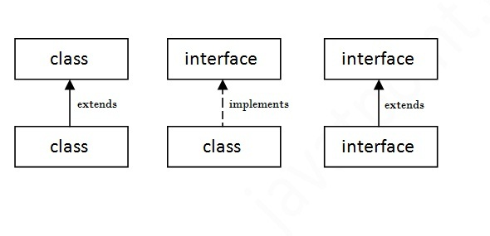
a class extends another class,
an interface extends another interface
but a class implements an interface.

Slide 5
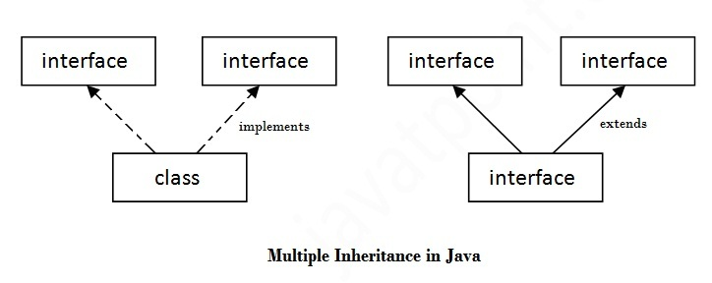
Multiple inheritance in Java by interface
If a class implements multiple interfaces, or an interface extends multiple interfaces
i.e. known as multiple inheritance.

Slide 6
interface Printable{ //First Interface
void print();
}
interface Showable{ //Second Interface
void show();
}
class A7 implements Printable,Showable{ //Class implements both the interface
public void print()
{System.out.println("Hello");}
public void show()
{System.out.println("Welcome");}
public static void main(String args[]){
A7 obj = new A7();
obj.print();
obj.show();
}
}

Slide 7
interface Printable{ //First Interface
void print();
}
interface Showable{ //Second Interface
void print();
}
class A7 implements Printable,Showable{ //Class implements both the interface
public void print()
{System.out.println("Hello");}
public static void main(String args[]){
A7 obj = new A7();
obj.print();
obj.show();
}
}

Slide 8
Multiple inheritance is not supported in case of class because of ambiguity.
But it is supported in case of interface because there is no ambiguity as implementation is provided by the implementation class.

Slide 9
Interface inheritance
A class implements interface but one interface extends another interface .
class TestInterface4 implements Showable{
public void print()
{System.out.println("Hello");}
public void show()
{System.out.println("Welcome");}
public static void main(String args[]){
TestInterface4 obj = new TestInterface4();
obj.print();
obj.show();
}
}
interface Printable{
void print();
}
interface Showable extends
Printable{
void show();
}

Slide 10
Default Method in Interface
interface Drawable{
void draw();
default void msg() //Default Method
{System.out.println("default method");}
}
class Rectangle implements Drawable{
public void draw()
{System.out.println("drawing rectangle");}
}
class TestInterfaceDefault{
public static void main(String args[]){
Drawable d=new Rectangle();
d.draw();
d.msg();
}}

Slide 11
Static Method in Interface
interface Drawable{
void draw();
static int cube(int x)
{return x*x*x;}
}
class Rectangle implements Drawable{
public void draw()
{System.out.println("drawing rectangle");}
}
class TestInterfaceStatic{
public static void main(String args[])
{
Drawable d=new Rectangle();
d.draw();
System.out.println(Drawable.cube(3));
}
}

Slide 12
Nested Interface in Java
An interface can have another interface i.e. known as nested interface.
interface printable{
void print();
interface MessagePrintable{
void msg();
}
}

Slide 13
Nested interface which is declared within the interface
interface Showable{
void show();
interface Message{
void msg();
}
}
class TestNestedInterface1 implements Showable.Message
{
public void msg()
{System.out.println("Hello nested interface");
}
public static void main(String args[]){
Showable.Message message=new TestNestedInterface1();
message.msg();
}
}

Slide 14
Nested interface which is declared within the class
class A{
interface Message{
void msg();
}
}
class TestNestedInterface2 implements A.Message{
public void msg()
{
System.out.println("Hello nested interface");
}
public static void main(String args[]){
A.Message message=new TestNestedInterface2();
message.msg();
}
}

